Slide 1
Welch Packaging Apprenticeship Program
Powered by: The Crossing

Slide 2
Who is Welch Packaging?

Slide 3
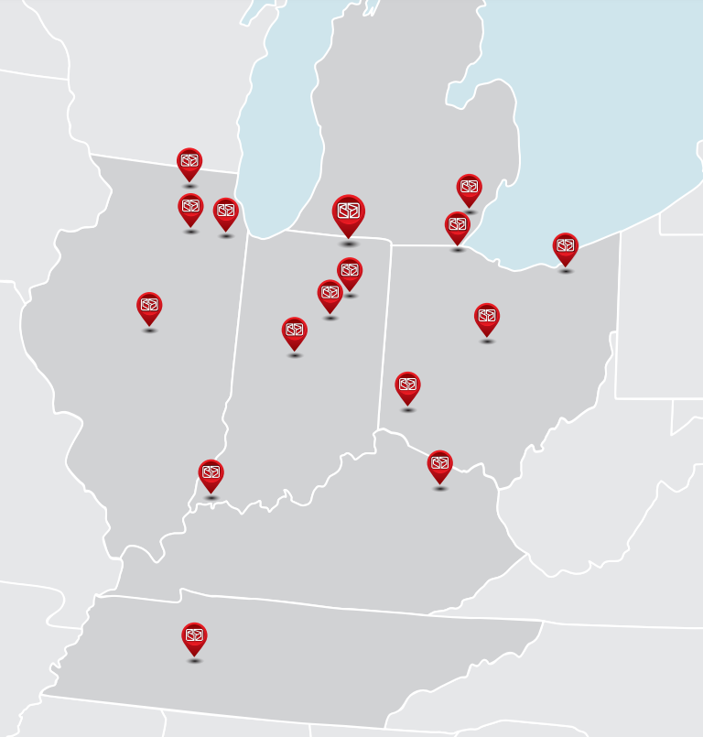
Family-owned corrugated manufacturing business headquartered in Elkhart, IN
Consistent growth since 1985
$500 million/year in annual revenue
Dedicated to developing our people through Welch University
16 locations across the Midwest
Family of corrugated packaging businesses

Slide 4
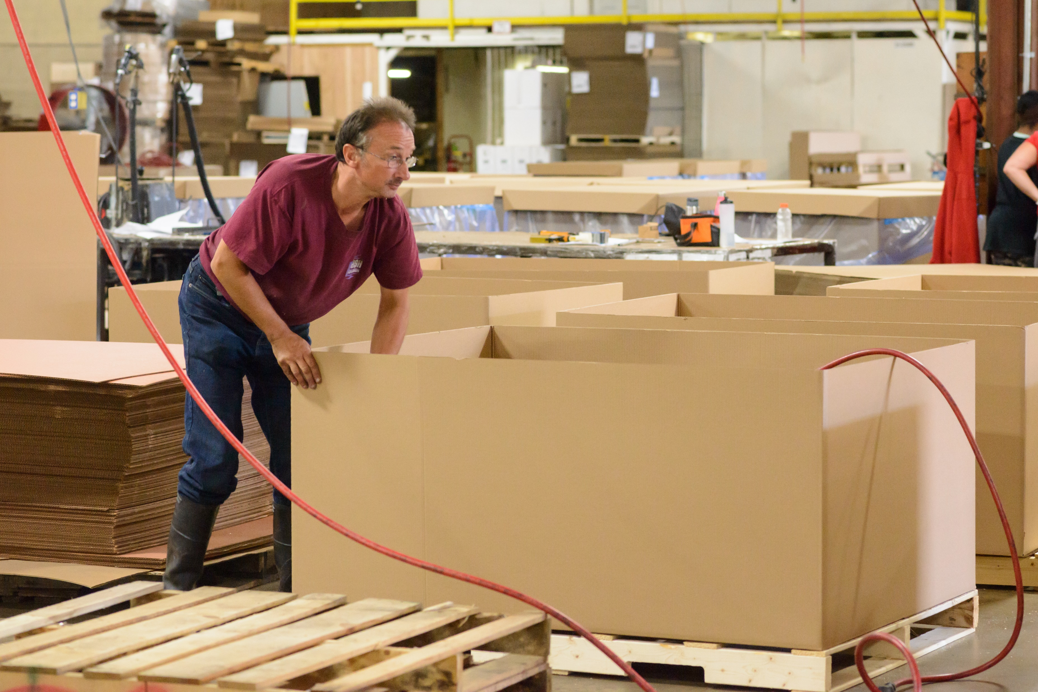
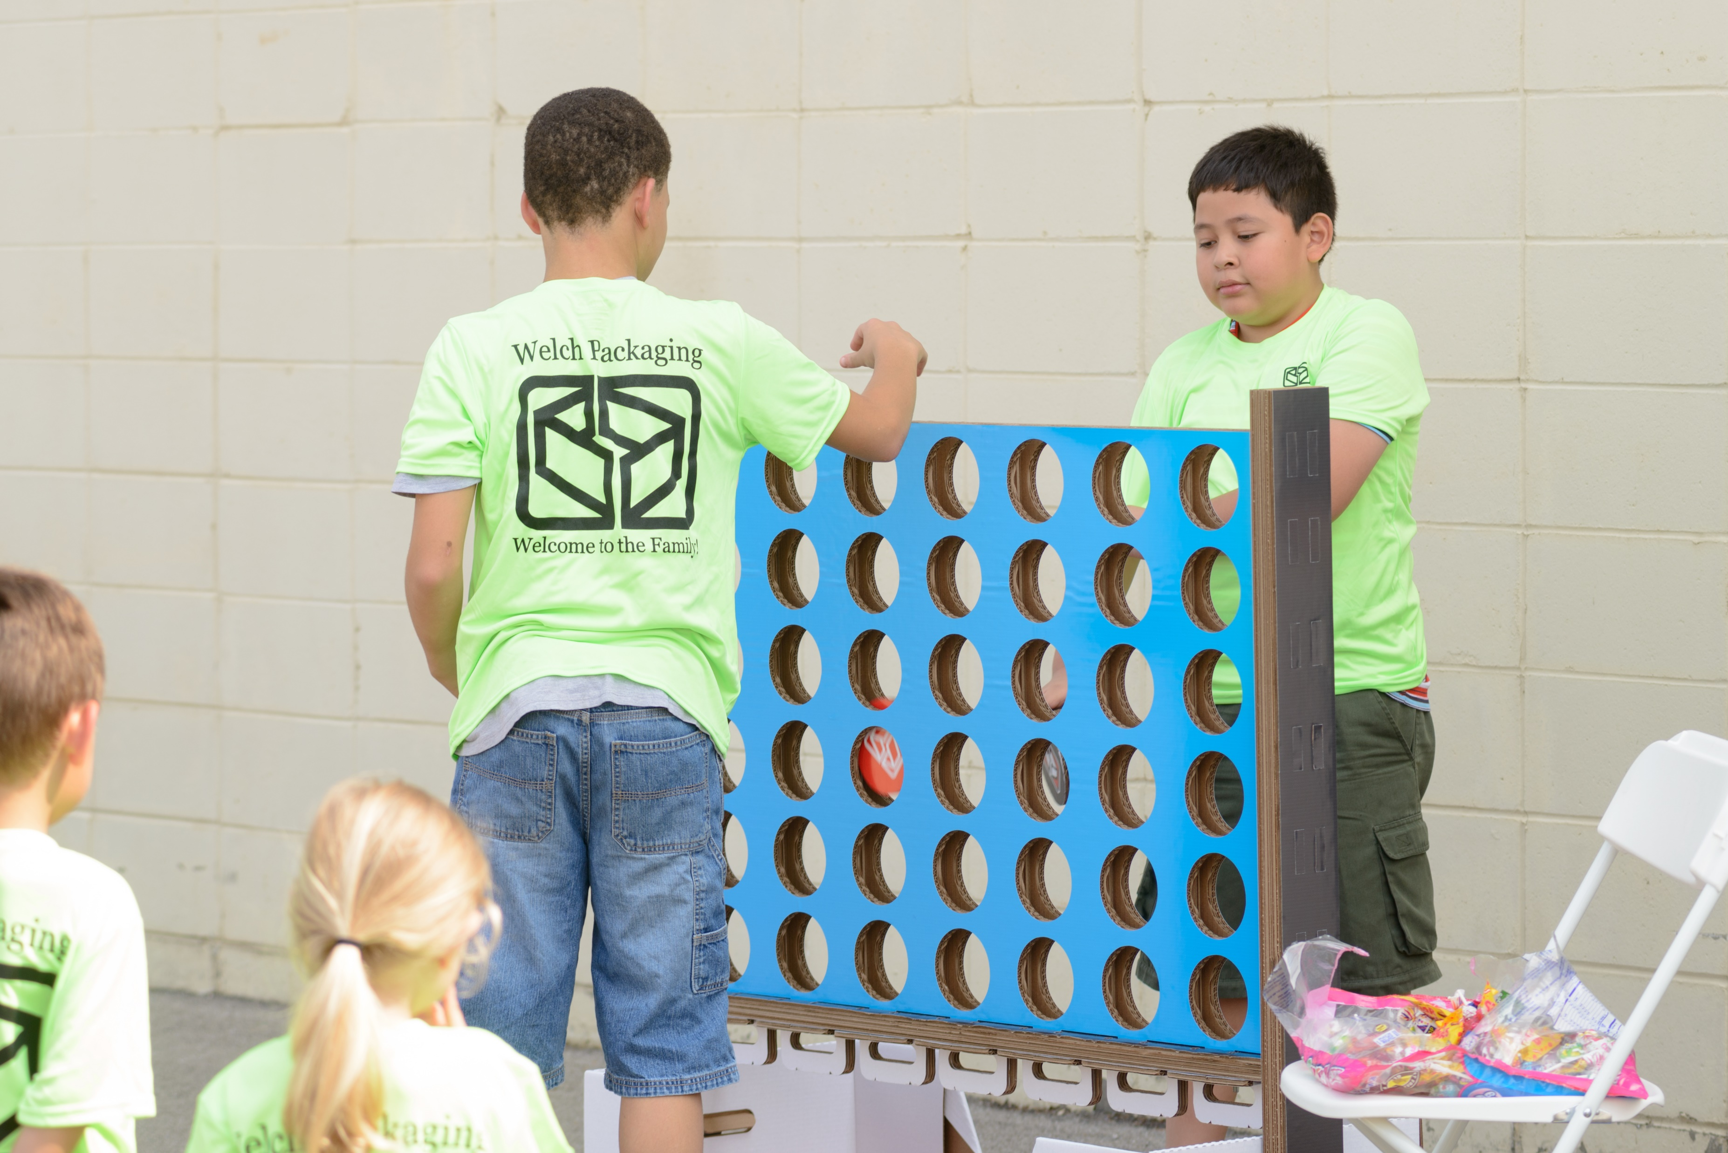
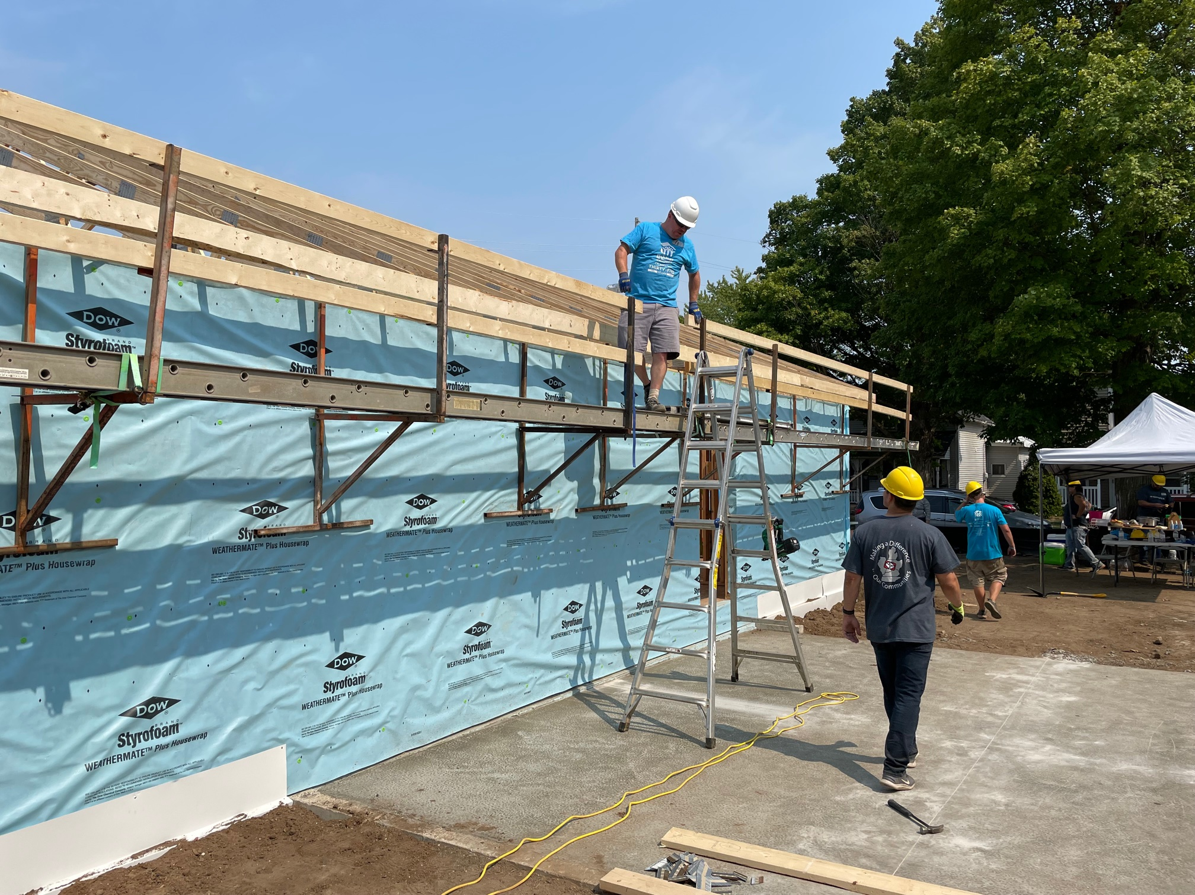
Vision
To Make a Difference in…
Our Customers’ Businesses
Our Associates’ Lives
Our Communities

Slide 5
Family
Service
Core Values
Integrity
Entrepreneurial Spirit

Slide 6
Welch Packaging Apprenticeship Program

Slide 7
Partnership
Aligns with our vision for community involvement
Welch is committed to creating a path for students to access living wage careers
This is an opportunity to build and strengthen the manufacturing workforce in Elkhart County
Provides opportunity for students who do not wish to attend a 4-year college to start a career

Slide 8
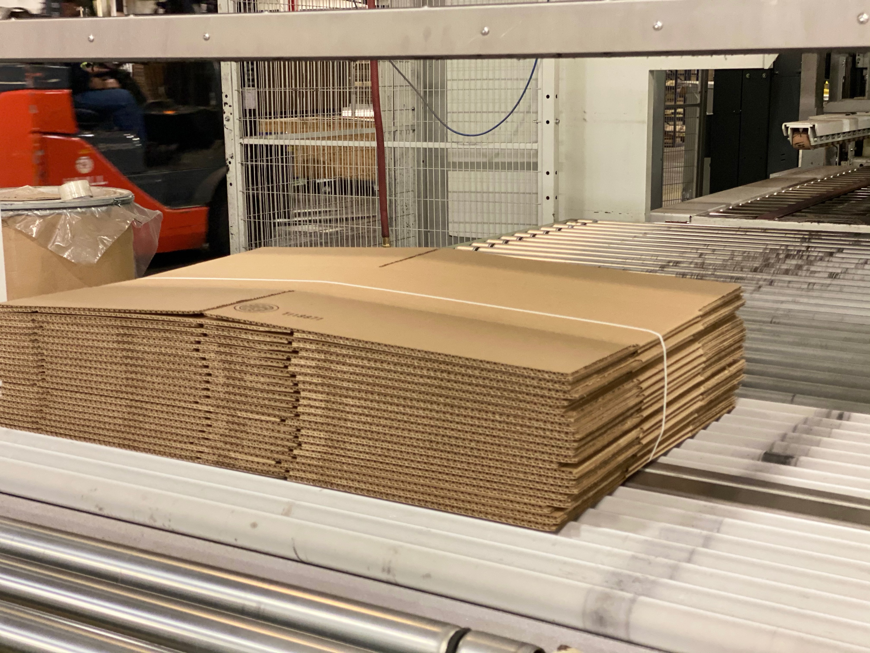
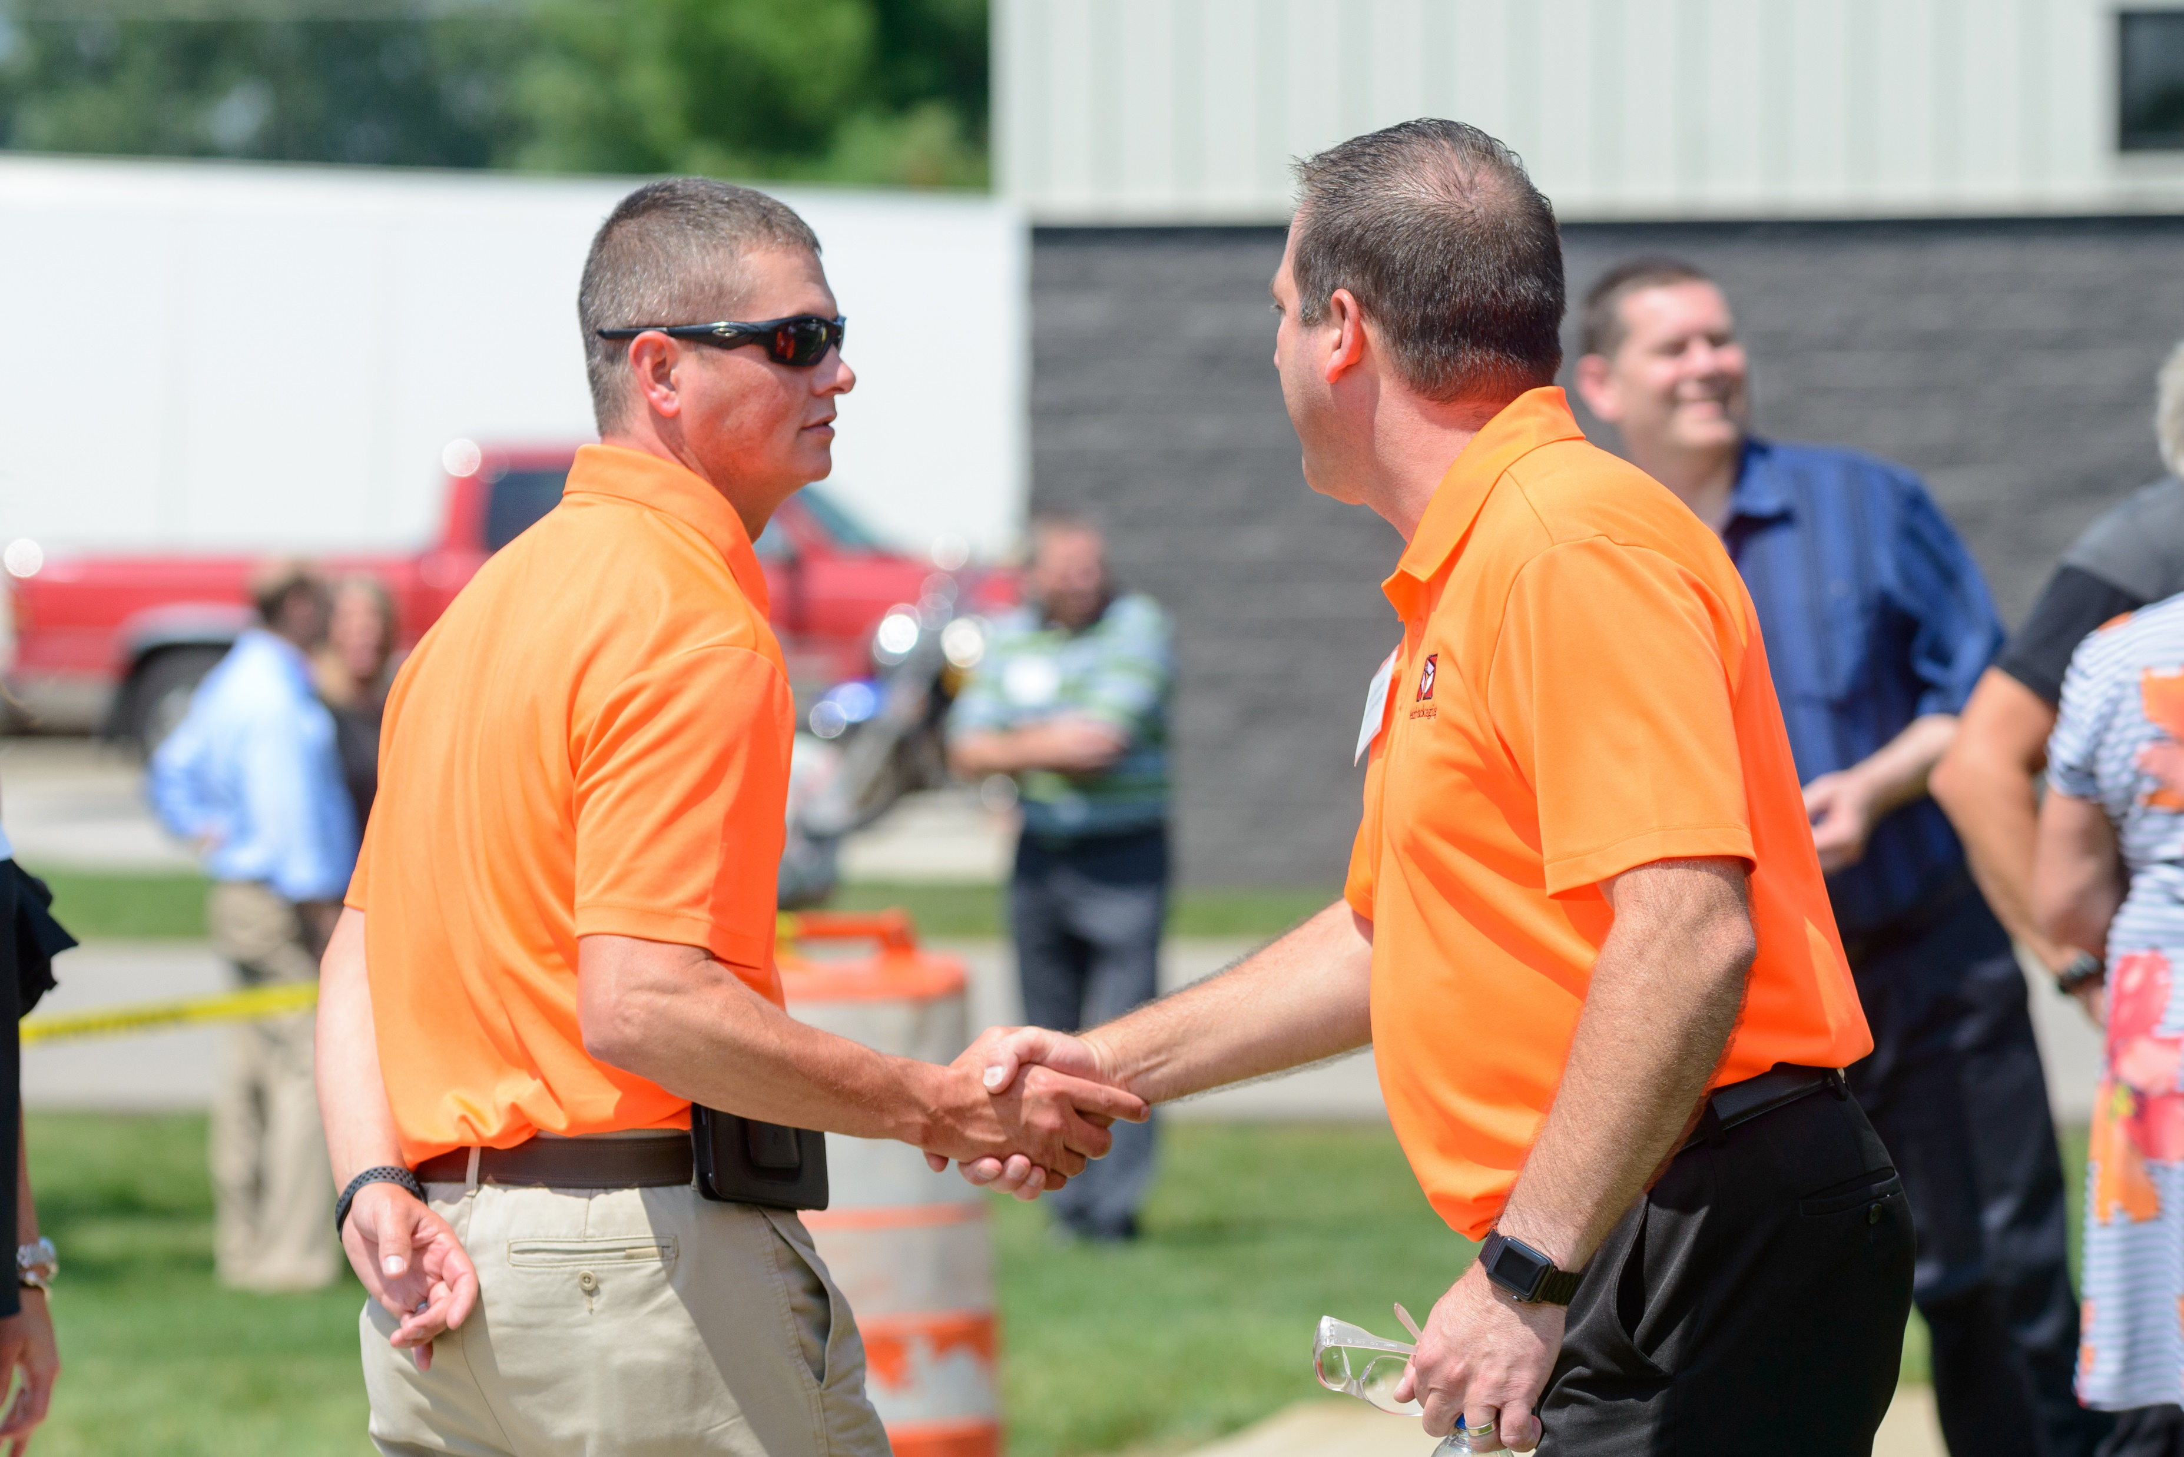
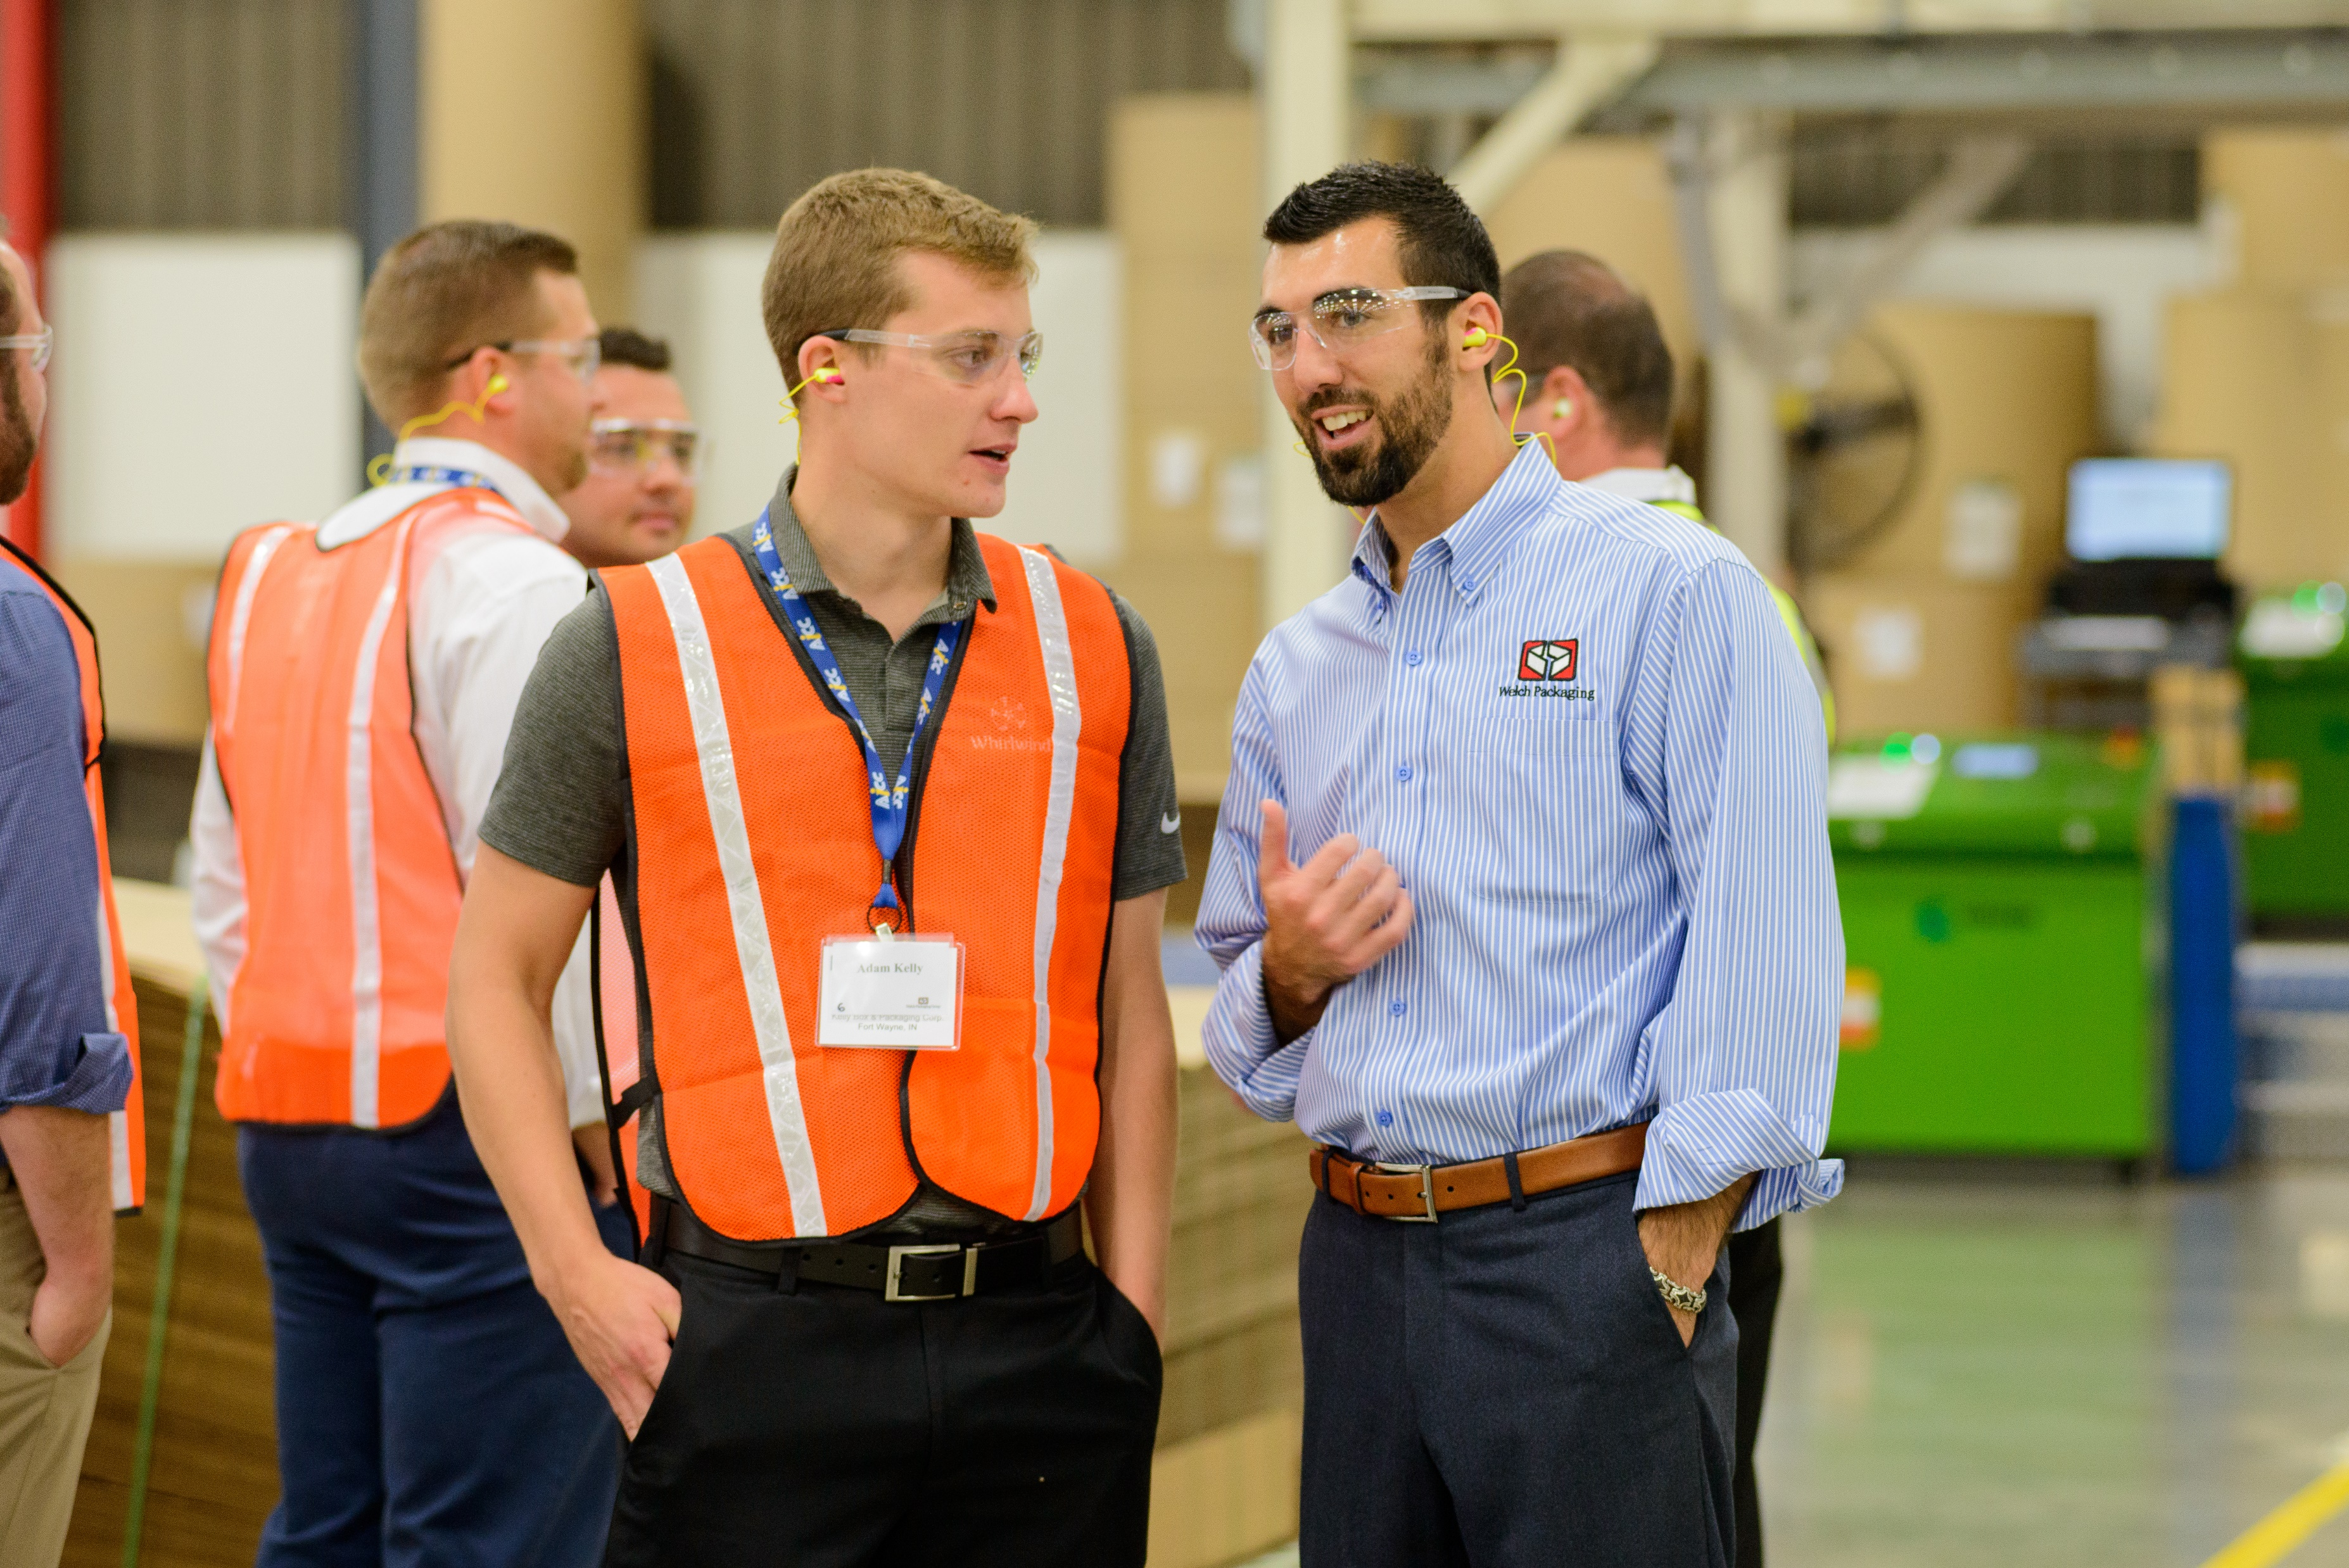
Introducing students to career opportunities within Welch Packaging & corrugated industry.
The goal is to retain students following graduation for full time roles at Welch Packaging
Notes:
Community involvement (long standing promise/vision)
Build access to living wage jobs
Help build manufacturing workforce in Elkhart County
Provide alternative career paths for students

Slide 9
Program Overview
Level 2: ‘Hand Assembly’
Work in H.A. Plant
Hands-on experience
Work 3 hour/day shifts
Part Time Paid
Level 3: ‘Multiple Plants’
Work in Brown Box Plant
Machine Experience
Work longer than 3hrs/day
Pay Increase possible (merit)
Level 1: ‘Classroom’
Mission/Vision/Values
Safety Training
Box Basics
Level Up Criteria
Attendance
Meet build goals
Work well with team
Stay on task
Understand importance of quality
Understand Load Tags
Master Safety Practices
Ability to use H.A. equipment
Level Up Criteria
Attendance
Steel Toed Shoes required
Add more hours to shift
Certifications
Level Up Criteria
Complete New Hire Onboarding
Have M/V/V lecture
Complete safety training with local safety coordinator
Complete Box Basics Course through Welch University
Notes:
**Will we pay these students initially (when they start working in Hand Assembly** ???
Part time pay potential

